Slide 1
How vector databases/stores are used for Generative AI services
Marius Sandbu
Sopra Steria | Cloud Evangelist
Marius.sandbu@soprasteria.com

Slide 2
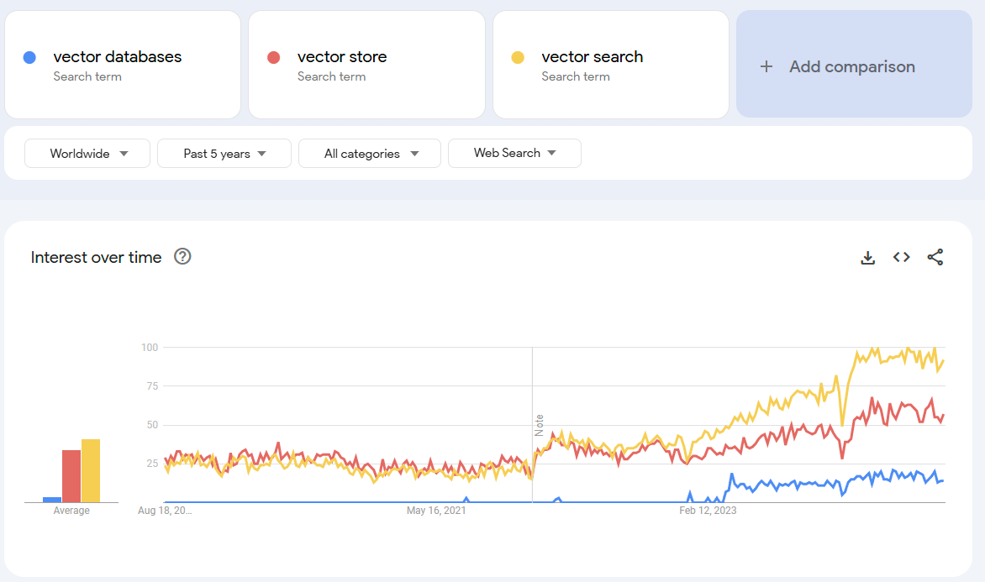
About time I start working on the presentation
WTF?! How do we use this with our own data
Wow ChatGPT is so cool

Slide 3
Large ecosystem of different models
GPT-4o
128k tokens
Function calling
Vision
Data Okt 2023
Cloud only
LLaMA3
8 eller 70 milliarder parametere
8k tokens
Data Des 2023
Can run locally
Claude 3 Opus
200k tokens
Function calling
Vision
Data August 2023
Cloud only
StarCoder2
3, 7, 15 milliarder parametere
16k tokens
Data August 2023
Can run locally
Microsoft Phi-3
3.8 milliarder parametere
128k tokens
Data Okt 2023
Can run locally
Google Gemma
2 eller 7 milliarder parametere
2k tokens
Data Des 2023
Kan kjøre lokalt
Mixtral 8x22
141 billion parametere
64k tokens
Function calling
Vision
Data August 2023
Can run locally
Command R+
141 billion parameters
64k tokens
Function calling
Vision
Data August 2023
Can run locally
Microsoft Phi-3
Google Gemini 1.5 Pro
1 million tokens
Function calling
Vision/Video
Data Okt 2023
Cloud only
Databricks DBRX
32k tokens
Function calling
Data Okt 2023
Can run locally
QWEN 1.5
Different moels
32k tokens
Function calling
Can run locally
Most of these models are not good at Norwegian (except GPT and Phi3.5)

Slide 4
How can we use our LLM’s with our own data?
Prompt Information directly into a prompt
1: Prompts
2: Fine-tuning
3: Grounding (RAG)
LLMs with our own data
Fine-tuning
Train the language model on your own data sources.
Prompts
Grounding (RAG)
Make data available outside the language model. Using search to retrieve data

Slide 5
RAG - (Retrieval Augmented Generation)
LLM
Vector Search
Search API
Vector Database/store
Convert data to vectors
Embeddings File ......0,1
«What is our policy on»
«This is our company policy
File splitter
Data
This is the method used in Microsoft 365 Copilot to retrieve data

Slide 6
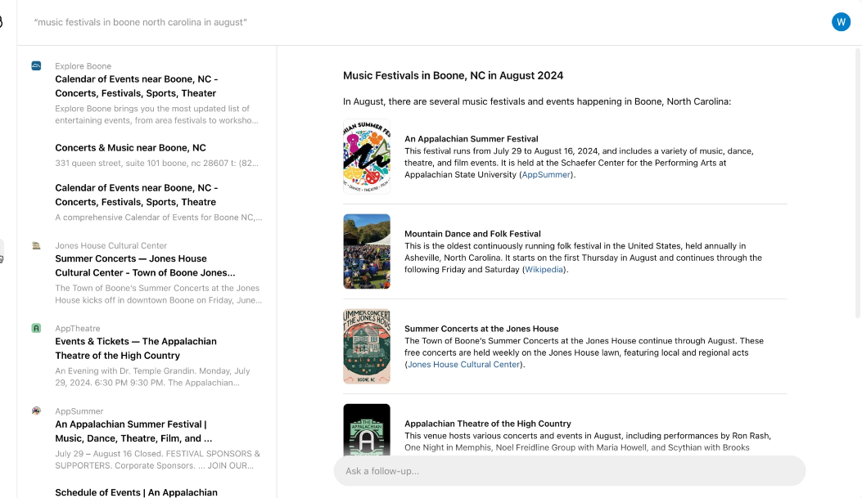
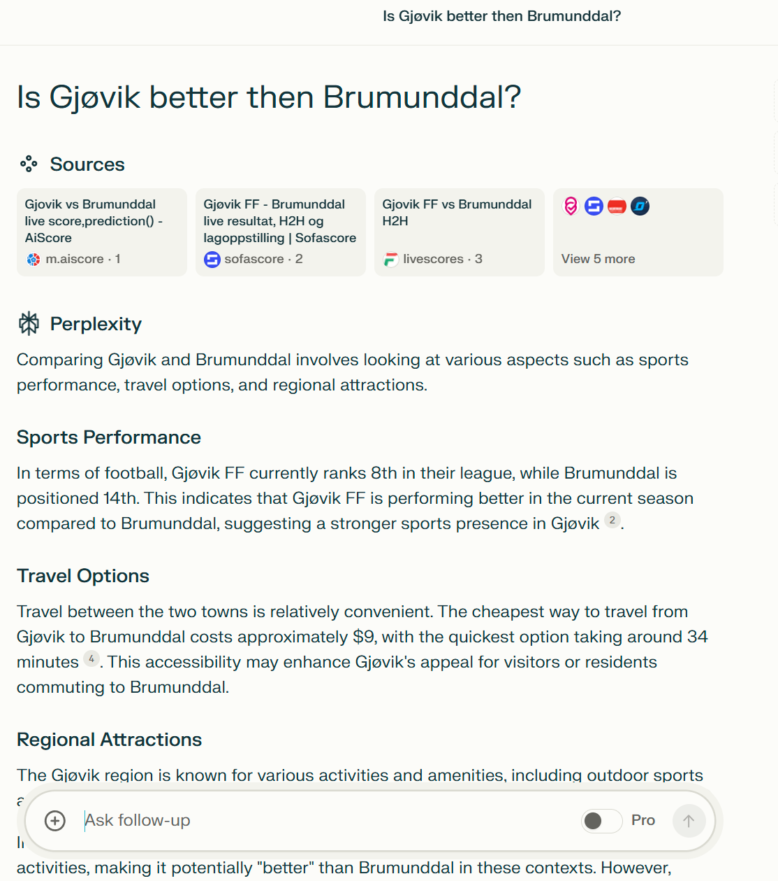
New ways using RAG to find information
SearchGPT fra OpenAI
Perplexity

Slide 7
Vector databases and semantic search
Who is the prime minister of Norway?
Vector Database
As section of text can be represented using hundreds of different dimensions
Vectors -0.02388945 0.05525852 -0.01165488
Search
Search function based on intent, context and meaning
Embedding of text
The Prime Minister of Norway is Jonas Gahr Støre
NOTE: An embedding model is used to convert the text into vectors
NOTE: A Vector store only has a "summmary" of the content and not the actual content itself

Slide 8

Search components important for RAG
Full text search («apple, fruit»)
BM25 Algoritm
Vector Search (0.8, 0.2)
Hybrid Search (apple, 0.8, 0.2)
Key words and vectors
Semantic Ranking
Top results ranked after semantics
Full text search first then ranked
Document 1: «I Love eating apples»
(Vector: 0.9, 0.1)
Document 3: Fruits like apples and oranges are health»
(Vector: 0.8, 0.1)
Document 2: «Apple Inc produces popular electronics»
(Vector: 0.1, 0.9)

Slide 9
Search methods in-depth
Search Method | Description | Advantages | Disadvantages | Use Cases
Exact Nearest Neighbor (NN) Search | Finds the closest vector(s) by comparing all vectors in the dataset. | Accurate results, simple to implement. | Slow for large datasets, high computational cost. | Small datasets, applications where accuracy is critical.
Approximate Nearest Neighbor (ANN) Search | Uses algorithms to quickly find vectors that are close enough, not necessarily the closest. | Faster than exact search, scalable to large datasets. | May not always find the true nearest neighbors. | Large-scale search, real-time applications.
Hierarchical Navigable Small World (HNSW) | Builds a graph of vectors where close vectors are linked, navigating through it to find the nearest ones. | Fast search, high accuracy, and good scalability. | Complex to implement, higher memory usage. | Large datasets, real-time search, recommendation systems.

Slide 10
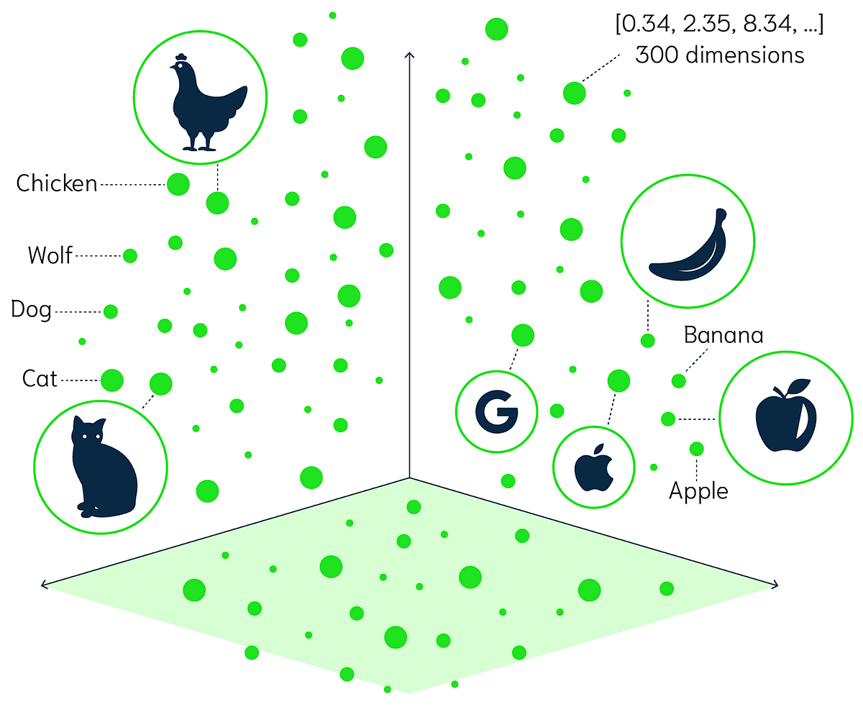
Embedding projector - visualization of high-dimensional data (tensorflow.org)

Slide 11
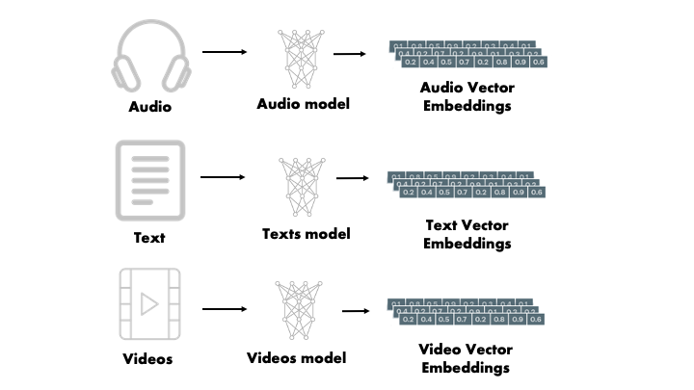
You cannot go from vectors back to the original data
Typically text embedding consists of hundreds of dimensions
Each frame of the video can be embedded

Slide 12
Search and vector store
Local vector stores
FAISS, NMSLIB, ANNOY, ScaNN
Vector-Only Databases
Azure AI Search
Pinecone Hybrid Search
Milvus
Databases that support vector store
MongoDB
PostgreSQL
Cosmos DB
Azure SQL
Azure AI Search
Hybrid Search
Index store (Text + vectors)
"value":
"@search.score": 1,
"content": “ Network traffic can be fully isolated to your network",
"content_vector":
0.008099633,
-0.013640393,
0.0052737766,

Slide 13
Difference between RDMS and Vector database
Feature | Vector Databases | Traditional RDBMS
Data Type | Primarily stores high-dimensional vectors (e.g., embeddings) | Stores structured data in tables with defined schema (rows and columns)
Data Model | Optimized for vector representations (e.g., dense, sparse vectors) | Relational model with tables, rows, and columns
Primary Use Case | Handling unstructured data for similarity search, nearest neighbor search, and machine learning applications | Transactional applications, business operations, and structured data management
Indexing | Specialized vector indexes (e.g., HNSW, IVF, ANNOY) for fast nearest neighbor search | Traditional B-trees, hash indexes, and bitmap indexes for exact match and range queries
Query Language | Typically uses APIs or custom query languages optimized for vector operations (e.g., similarity search) | SQL (Structured Query Language) for structured queries and transactions
Query Types | Nearest neighbor search, similarity search, range search on vector spaces | CRUD operations (Create, Read, Update, Delete), joins, aggregations, transactions
Performance Optimization | Optimized for fast retrieval of high-dimensional vector data; leverages GPU acceleration and approximate nearest neighbor search | Optimized for transactional integrity and ACID properties; relies on disk I/O and caching for performance
Scalability | Designed to handle large-scale unstructured data and vector embeddings, often using distributed architectures | Scales well for structured data with vertical scaling (adding more resources to a single machine) and horizontal scaling (sharding)
Examples | Pinecone, Faiss, Milvus, Weaviate, Annoy | MySQL, PostgreSQL, Oracle, Microsoft SQL Server, SQLite

Slide 14
Difference between RDMS and Vector database
Feature | Vector Databases | Traditional RDBMS
Data Type | Vectors | Tables
Data Model | Vector-based | Relational
Primary Use Case | Similarity Search | Transactions
Indexing | Vector Indexes | B-trees
Query Language | API | SQL
Query Types | Nearest Neighbor | CRUD
Scalability | Distributed | Vertical/Horizontal
Examples | Pinecone | MySQL

Slide 15
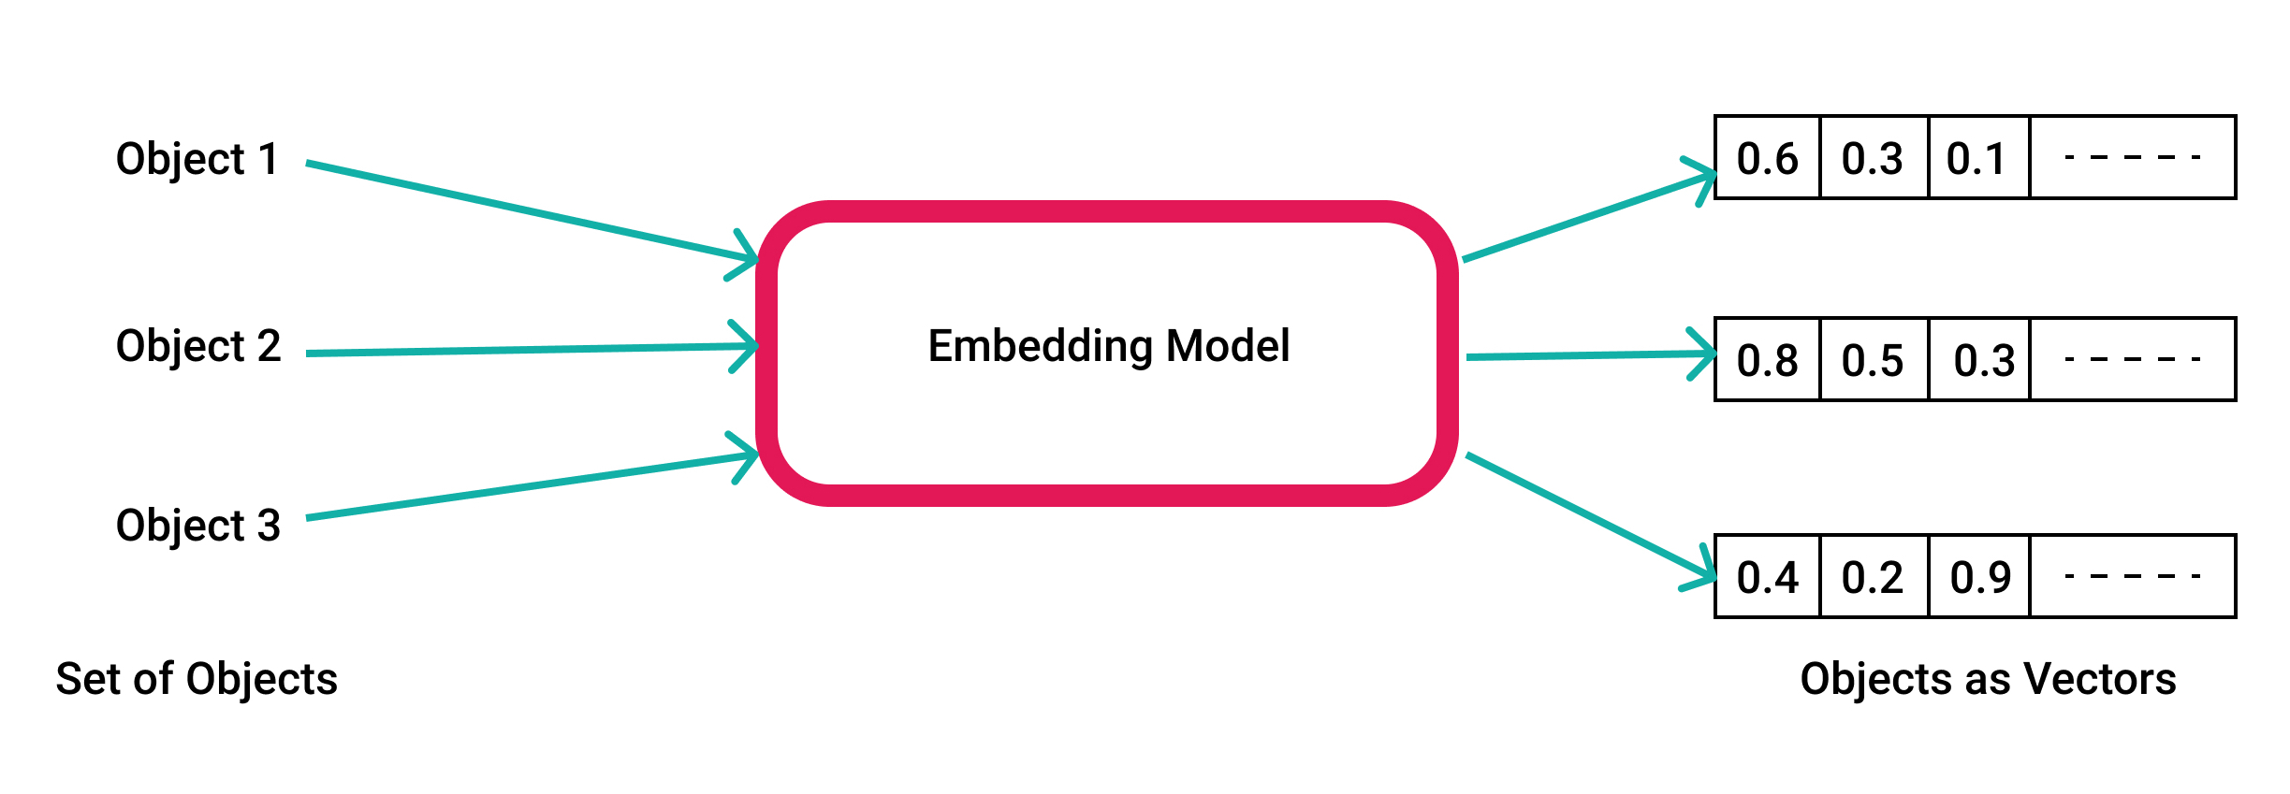
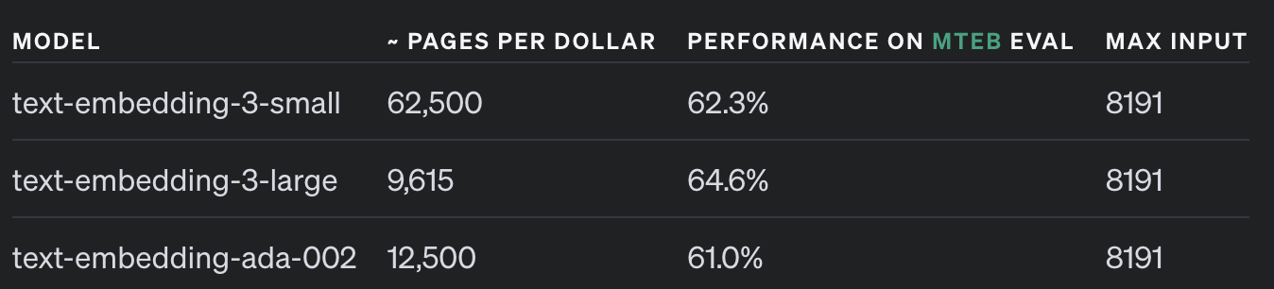
Embedding of information
NOTE: There are many different embedding models, OpenAI provides some of them (Default length is 1536 dimensions)

Slide 16
Embedding of information
Model | Dimensions | Max Tokens | Open Source | Multilingual | Strengths | Weaknesses
OpenAI text-embedding-3-large | 3072 | 8192 | No | Yes | High accuracy, regularly updated | Closed-source, API costs
Cohere Embed v3 | 1024 | 512 | No | Yes (100+ languages) | Compression-aware training, high performance on noisy data | API costs
Voyage AI (lite-02-instruct) | 1024 | 4000 | No | Yes | Specialized for retrieval tasks, supports different input types | Less widely adopted
BAAI/bge-large-en-v1.5 | 1024 | 512 | Yes | No (English-only) | Strong performance, open-source | Limited to English
UAE-large-V1 | 1024 | 512 | Yes | Yes | Good performance on semantic similarity tasks | May require more computational resources
Sentence-BERT (various) | 384-1024 | 128-512 | Yes | Model-dependent | Flexible, customizable, many pre-trained options | Performance varies by specific model
Google's Generative AI Embeddings | 768-1024 | Model-dependent | No | Yes | Optimized for different task types, easy integration with Google Cloud | API costs, less flexibible
MTEB Leaderboard - a Hugging Face Space by mteb

Slide 17
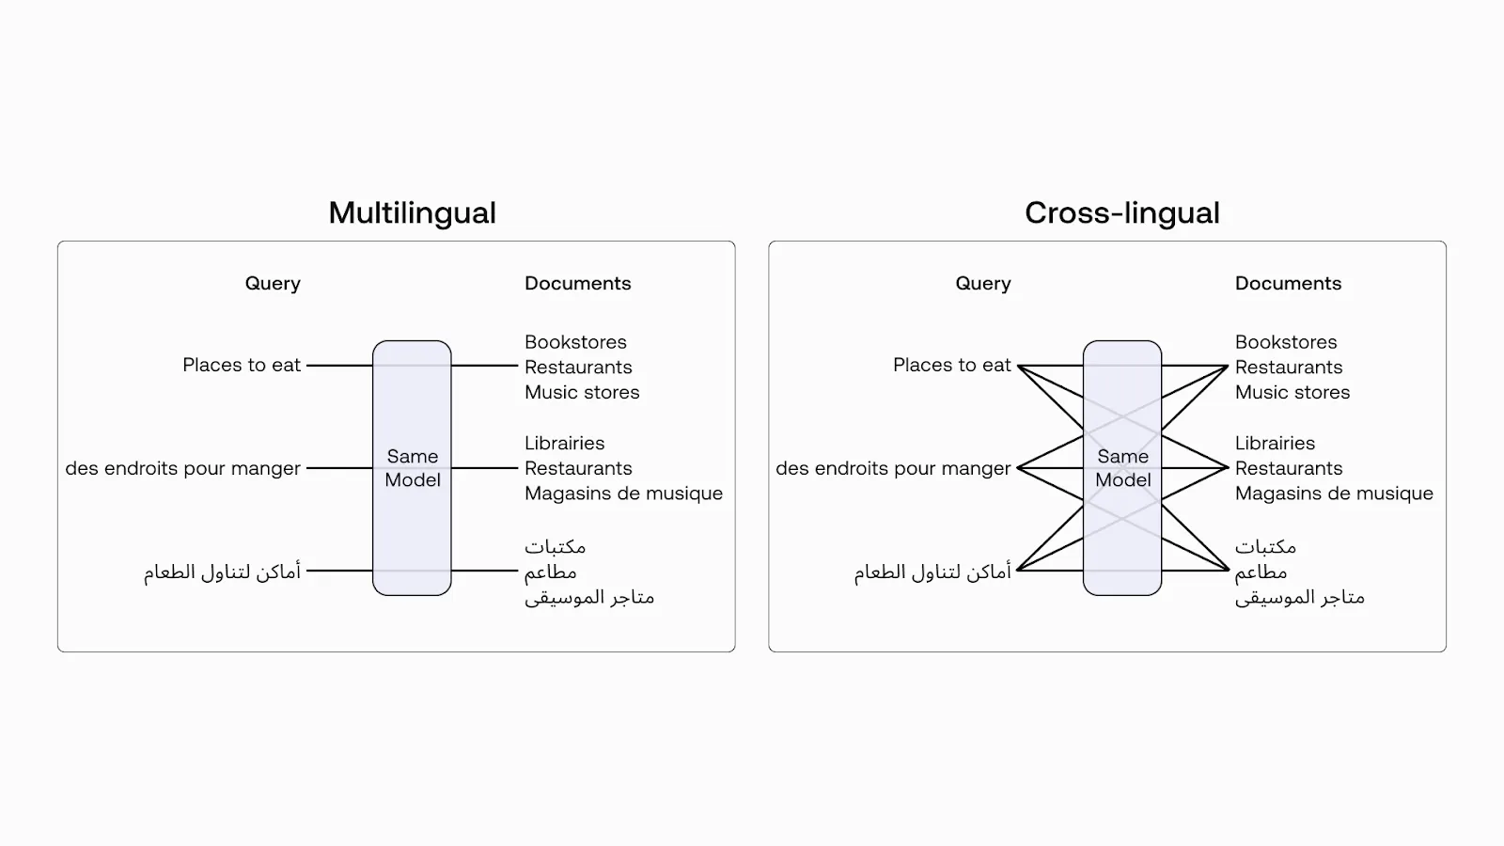
Cross-lingual
Example using Cohere Embedding model

Slide 18
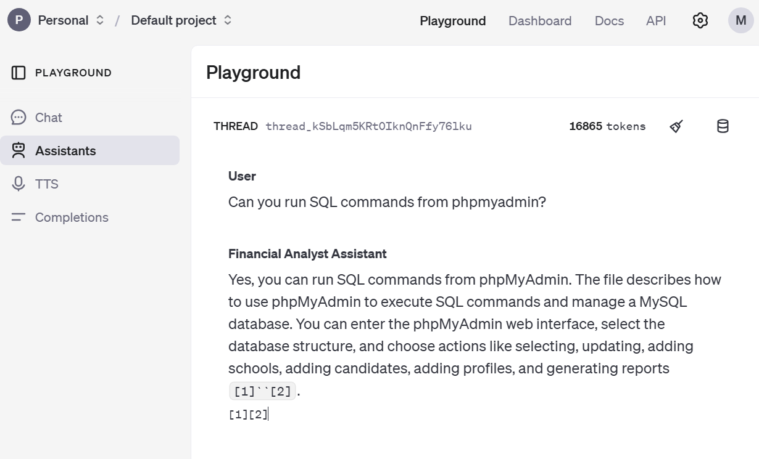


Embedding example
OpenAI Vector Store
Assistant
Limited support for different file types and limits to how much data can be stored
File upload (txt, md, pdf and docx)

Slide 19
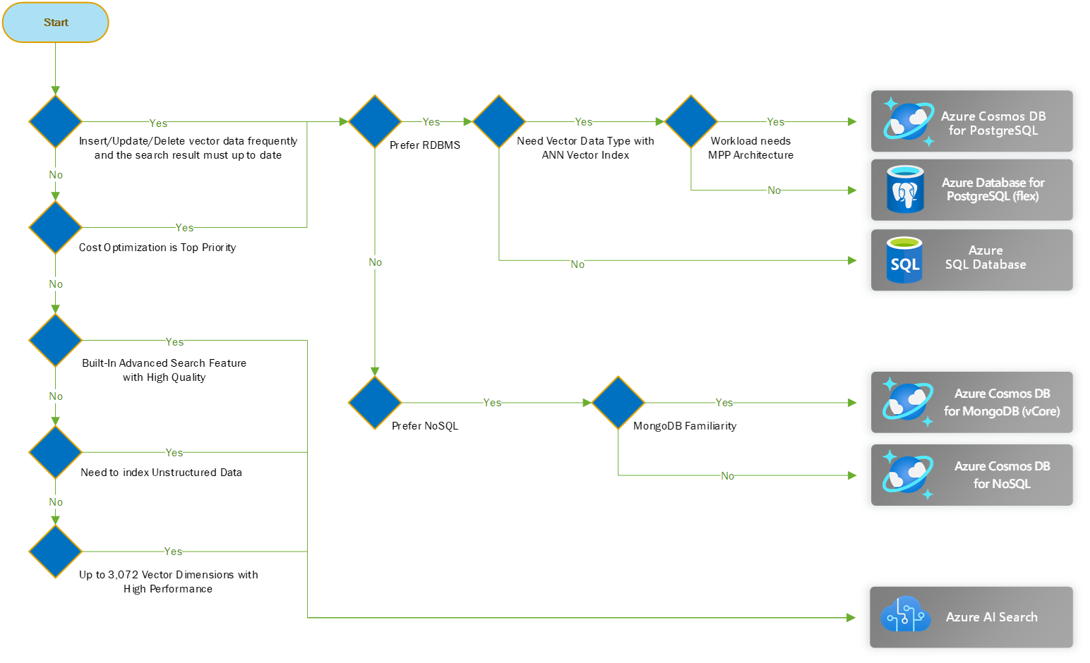
Pros / Cons of different vector stores (Microsoft)

Slide 20

Enter Azure PostgreSQL
PGVector = extension that adds support for vector data types and vector similarity search
azure_local_ai = local embedding model on a memory optimized SQL Server
azure_ai = extension that allows seamless integration of Azure AI services, such as Azure OpenAI and Azure AI Language, directly into Azure PostgreSQL

Slide 21
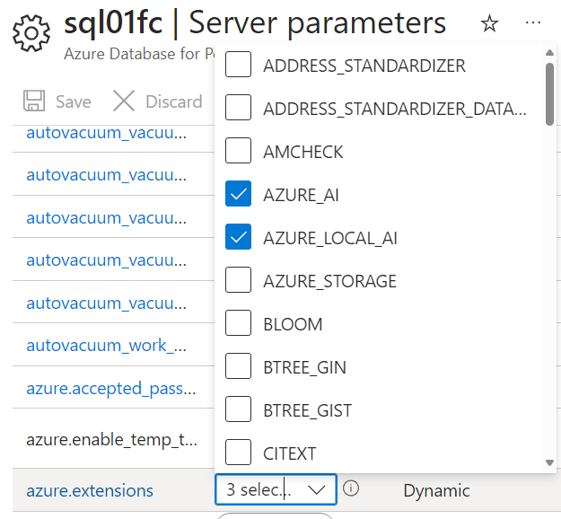
Local embedding Azure PostgreSQL
Local embedding (Required Memory Optimized machine)
<4 vCPUs
Faster embedding and lower cost (Doesn’t require external API)
In preview (available from certain regions)
Require AZURE_LOCAL_AI Extension installed
Only one embedding model available - multilingual-e5-small:v1
For complex text and information might not provide the best semantic context of the information

Slide 22
Local embedding Azure PostgreSQL
CREATE TABLE docs(doc_id int generated always as identity primary key, doc text not null, embedding float4[], last_update timestamptz default now());
INSERT INTO docs(doc) VALUES ('Create in-database embeddings with azure_local_ai extension.'),
('Enable RAG patterns with in-database embeddings and vectors on Azure Database for PostgreSQL - Flexible server.'),
('Generate vector embeddings in PostgreSQL with azure_local_ai extension.'),
('Generate text embeddings in PostgreSQL for retrieval augmented generation (RAG) patterns with azure_local_ai extension and locally deployed LLM.'),
('Use vector indexes and Azure OpenAI embeddings in PostgreSQL for retrieval augmented generation.');
-- Add a vector column and generate vector embeddings from locally deployed model
ALTER TABLE docs
ADD COLUMN doc_vector vector(384) -- multilingual-e5 embeddings are 384 dimensions
GENERATED ALWAYS AS (azure_local_ai.create_embeddings('multilingual-e5-small:v1', doc)::vector) STORED; -- TEXT string sent to local model

Slide 23
Local embedding Azure PostgreSQL with similiarty search
CREATE DATABASE sqlsaturday2
CREATE EXTENSION vector;
CREATE EXTENSION azure_local_ai;
create table docs(doc_id int generated always as identity primary key, doc text not null, last_update timestamptz default now(), embedding float4[]
GENERATED ALWAYS AS (azure_local_ai.create_embeddings('multilingual-e5-small:v1', doc)) STORED);
INSERT INTO docs(doc) VALUES ('Create in-database embeddings with azure_local_ai extension.'),
('Enable RAG patterns with in-database embeddings and vectors on Azure Database for PostgreSQL - Flexible server.'),
('Generate vector embeddings in PostgreSQL with azure_local_ai extension.'),
('Generate text embeddings in PostgreSQL for retrieval augmented generation (RAG) patterns with azure_local_ai extension and locally deployed LLM.'),
('Use vector indexes and Azure OpenAI embeddings in PostgreSQL for retrieval augmented generation.');
with all_docs as (
select doc_id, doc, embedding
from docs
), target_doc as (
select azure_local_ai.create_embeddings('multilingual-e5-small:v1', 'Generate text embeddings in PostgreSQL.') embedding
)
select all_docs.doc_id, all_docs.doc , 1 - (all_docs.embedding::vector <=> target_doc.embedding::vector) as similarity
from target_doc, all_docs
order by similarity desc
limit 5;

Slide 24
OpenAI Embedding with Langchain
CREATE TABLE docs(doc_id int generated always as identity primary key, doc text not null, embedding float4[], last_update timestamptz default now());
INSERT INTO docs(doc) VALUES ('Create in-database embeddings with azure_local_ai extension.'),
('Enable RAG patterns with in-database embeddings and vectors on Azure Database for PostgreSQL - Flexible server.'),
('Generate vector embeddings in PostgreSQL with azure_local_ai extension.'),
('Generate text embeddings in PostgreSQL for retrieval augmented generation (RAG) patterns with azure_local_ai extension and locally deployed LLM.'),
('Use vector indexes and Azure OpenAI embeddings in PostgreSQL for retrieval augmented generation.');
-- Add a vector column and generate vector embeddings from locally deployed model
ALTER TABLE docs
ADD COLUMN doc_vector vector(384) -- multilingual-e5 embeddings are 384 dimensions
GENERATED ALWAYS AS (azure_local_ai.create_embeddings('multilingual-e5-small:v1', doc)::vector) STORED; -- TEXT string sent to local model

Slide 25
Azure PostgreSQL
Local embedding AI on Azure PostgreSQL
+ Cheaper (Free), Faster
- Not as good as OpenAI Models, not that customizable
Local embedding works best if you have English content and generic information
OpenAI Embedding
+ The best embedding model (Higher Quality Content) + Better language support + Better ecosystem and integration
- Cost and Performance

Slide 26
Azure AI Search
Search service for vector search and full text and hybrid search
Indexing with integrated data chunking and vectorization
Is not able to store data according to a schema
Used for traditional full text search and vector similarity search
Hierarchical Navigable Small World (HNSW) or exhaustive K-Nearest Neighbors (KNN) to find similar vectors

Slide 27
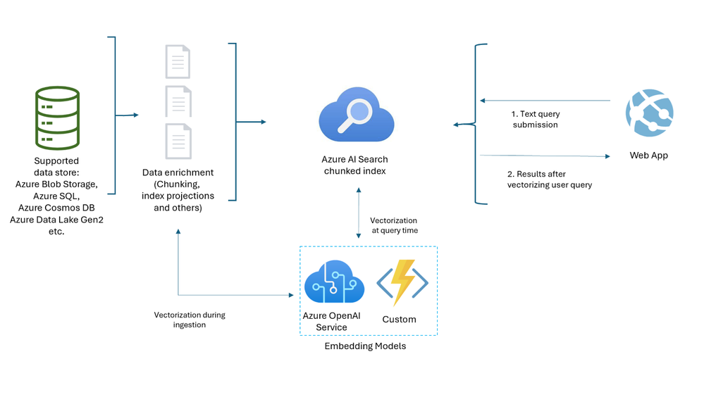
Azure AI Search
Supports different data sources and can automatically embed data (text, images)

Slide 28
Azure AI Search
Easily integrated into Copilot Studio or Teams
Easy to make data available through a RAG application
Supports different data sources (and different types of content)
Customizable search parameters and functions
- Made for making a search index for data
- Can be quite costly if not managed properly
- Still requires data to be stored "elsewhere"

Slide 29
Summary – When to use what?
Feature | PostgreSQL + pgvector | Azure AI Search | OpenAI Vector Storage
Open-source | Yes | No | No
Managed service | Optional (Azure) | Yes | Yes
Indexing options | Multiple | Limited | Proprietary
AI integration | Manual | Azure OpenAI | Native OpenAI
Ecosystem | PostgreSQL | Azure | OpenAI
PostgreSQL: Enhancing data in SQL with similarty search (such as for eCommerce) or custom applications
Azure AI Search: Source for RAG Applications tied into the Microsoft ecosystem either custom applications or Copilot
OpenAI: Made for custom chatbots with small datasets

Slide 30
So why a Vector Store/Database?
Make unstructured data into vector representations for enhanced natural language understanding and retrieval
Research which embedding model you should use for your service
Will never be able to adopt a 1:1 mapping between the context in the original data source and the result the model will generate
Improvements in the embedding models increase quality and support for other content (pictures, videoes)
Depending on use-case and amount of data one should look at dedicated vector stores
Remember that vector stores do not store the actual data but only metadata

Slide 31










Thank you to our sponsors

Slide 32
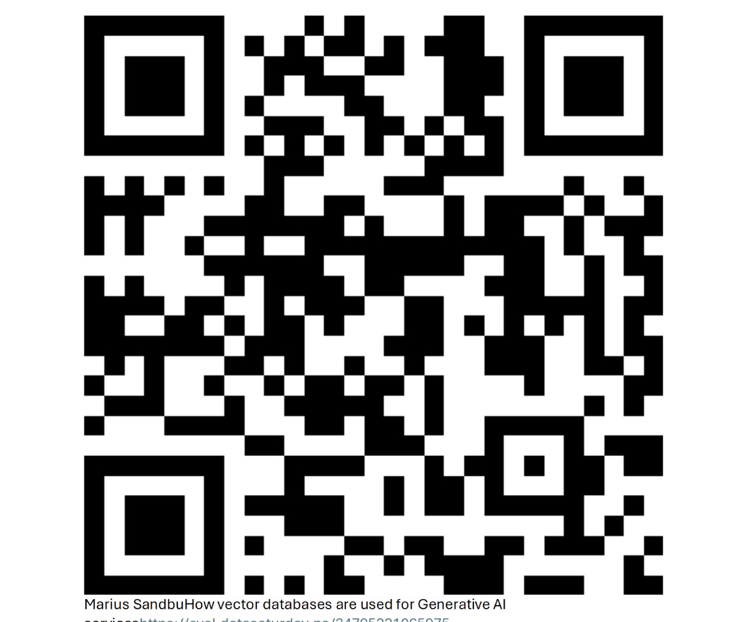
Feedback to the session

